Slide 1
Detecting Movement in an Array Network Using a Semi-Supervised Localization Method and MRFs

Slide 2
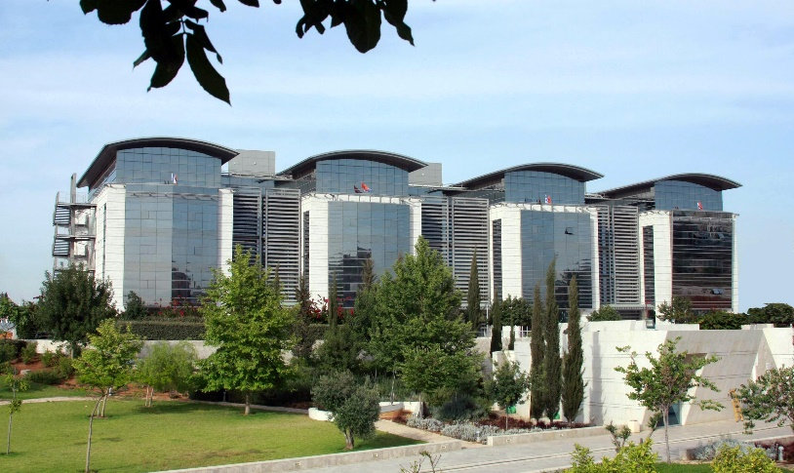

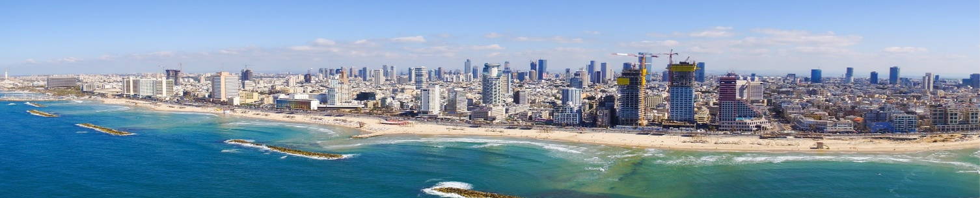
Introduction
Notes:
I wanted to begin by recognizing the university where I was fortunate to be able to do my research, Bar-Ilan Uni in Israel, specifically, Ramat Gan. {CLICK}
In particular, I worked with Prof. Sharon Gannot and his group at the Signal Processing Lab. Here is the Alexander Kofkin Faculty of Engineering building where his lab resides (building on far left).
I mentioned that the university is in Ramat Gan, however, I decided to stay in Tel Aviv. If any of you are planning a stay at Bar-Ilan, I’d be happy to discuss the pros/cons of living in Tel-Aviv after.

Slide 3
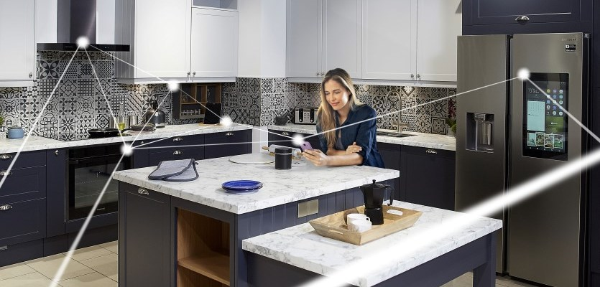
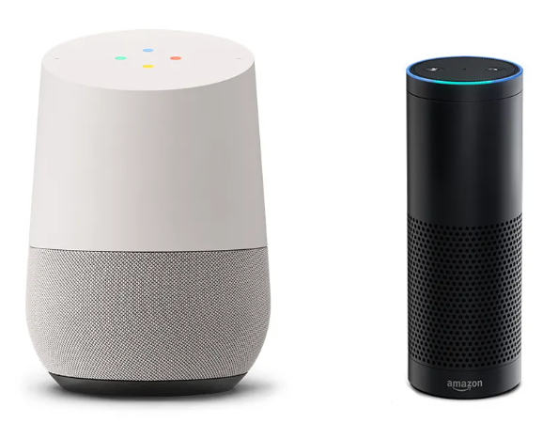
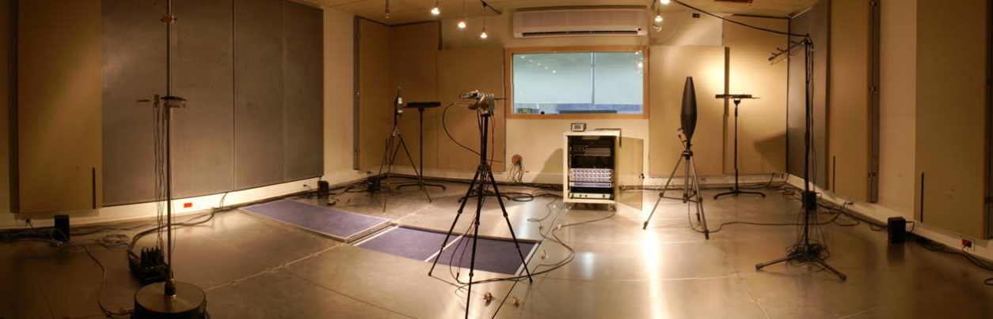

Project Background
https://degeekit.ie/google-home-vs-amazon-echo-in-ireland/
https://www.eng.biu.ac.il/gannot/files/2012/05/image017.jpg
https://energyefficientsmart.com/5-ways-to-make-your-smart-home-more-energy-and-cost-efficient/
https://www.nytimes.com/wirecutter/blog/amazon-echo-dot-vs-google-home-mini/
Notes:
This here is the Acoustic Lab at Bar Ilan operated by Prof. Gannot and his lab. It’s worth noting a good amount of the research that they do regards sound source localization. So for my research project, this was, broadly speaking, the focus.
We know source localization to be an essential component in different audio-related applications, including: automated camera steering and teleconferencing systems [1], robot audition [3]–[5], and generally speaking in the context of smart home environments {CLICK}. We already know that there are many companies now that embed sensors and microphones in every day appliances. Of course, though to really be a smart-home, there needs to be fluidity in how these different devices communicate.
{CLICK} The use of microphones are already central to the smart-home concept. I’m sure we’re all familiar with the Google Home and Amazon Echo. Of course they’re not the end of the story for smart home tech. We already see products like the Amazon dot or Google Nest, being developed and marketed as not only alternatives to the originals but apart of a larger network embedded throughout one’s home.
For these devices, it goes without saying that robust sound source localization techniques will be essential in ensuring the fluidity of the overall environment.
An obvious example of course for the need of robust localizer is for potential signal enhancement or for interpreting spatial context like someone saying “Turn on the lights”.
One of the main challenges right now we face as a research community is how to perform robust localization in adverse conditions, meaning, in the presence of background noise and reverberation.
One solution introduced by Prof. Gannot and one of his Ph.D. students, Bracha Laufer-Goldshtein, was a learning-based method that leverages the fact that smart-home environments are essentially static, and therefore a great deal of the features describing the room can be learned in a training phase and stored.

Slide 4
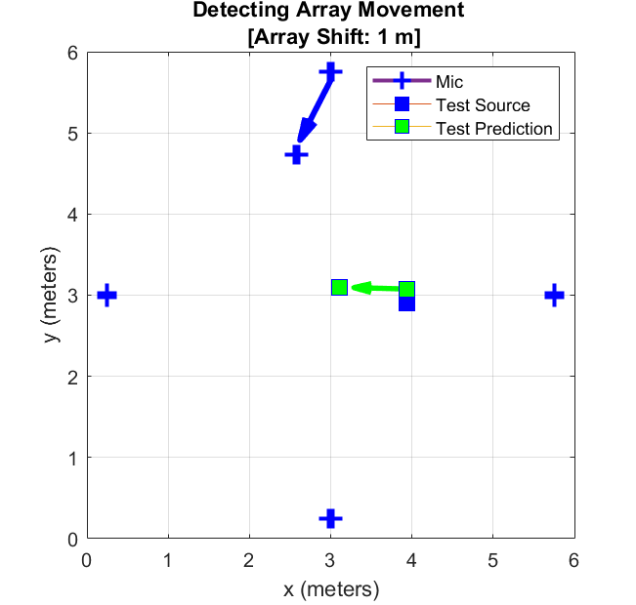
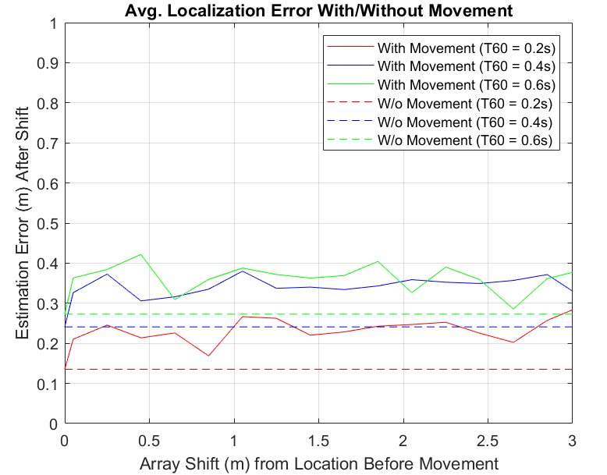
Motivation
Notes:
So as we’ll see when we dive deeper into the Bracha’s localization technique, essentially the characteristics of an acoustic environment are learned during a training phase with each microphone node providing to the localization effort in a sense a specific viewpoint based on it’s own position in the room. One of the issues that we initially looked at, was what happens when an array in a given network is moved.
However if one of these nodes were to be moved, we noticed, and as you can see here (GO SLOW), the localization error can be quite significant. So here we report the average error while incrementally moving a random array in a random direction with random rotation. The results here are reported for varying T60s and in the dotted line, we report the average error of the localizer for different T60s without movement. As you can see there are times when the average error after movement is almost twice the average without movement.
This of course indicates something needs to be done to update our network
While this solution is still unclear, one of the proposals we knocked around was dropping the faulty array’s contribution to the estimate. Of course this isn’t optimal for everyday use as these measurements can be time demanding to obtain. Therefore if at all possible we would like to save a given node and it’s contribution, that is of course assuming it’s measurement is still accurate.
What this means specifically is we want a detection method that relies on the error in some sense.
Unfortunately, as you can see, the average error isn’t really proportional to the size in shift, therefore, something like accelerometer which is equipped in some sensors wouldn’t be applicable if our goal is to see if a node was still making accurate predictions. Also note though that error itself isn’t well correlated the size in shift either and therefore doesn’t lend well to thresholding. Also, an estimate made by the full network isn’t really conducive to identifying which node is corrupt.
So what we set out to do, was see if there was a way to indicate if movement in the network occurred based off of the localization error, in order to try and salvage learned information that may be costly to reacquire after a given node is moved.

Slide 5
Outline
Motivation
Semi-Supervised Gaussian Process (SSGP) Source Localization Method
Misalignment Detection Using Markov Random Fields (MRFs)
Results
Conclusion

Slide 6
Goals
Long-term goal: localize a source even if a microphone node is moved.
Salvage training data (if estimation results are still good).
Otherwise, consistently identify which array has moved.
Notes:
To briefly recap the goals of this project before diving deeper. First and foremost we want to be able to identify when an array has moved. For now we assume a static source.
{CLICK} We hope the results are proportionate to the error. Again, in order to preserve training data if at all possible.
{CLICK} And then lastly, though it’s not addressed in its entirety today, we hope for the detection method to be apart of a framework that allows for robust sound localization even if a node is moved.

Slide 7
SSGP source localization

Slide 8
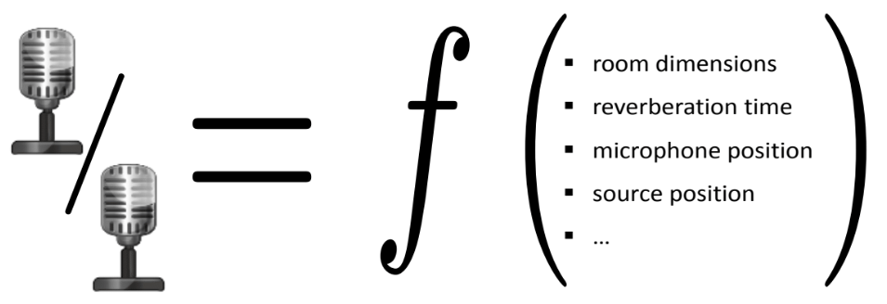
Relative Transfer Functions (RTFs)
Acoustic Transfer Function (ATF): precise model, but difficult to estimate [1,2,3].
RTF: represents the fingerprint for a given acoustic environment (easier to estimate).
Source positioning
T60
Mic positioning
Room dimensions
…
Source positioning
T60
Mic positioning
Room dimensions
…
Assumption: in smart-home environments, ATFs and RTFs depend on a small number of variables.
https://www.eng.biu.ac.il/gannot/tutorials-and-keynote-addresses/
Notes:
We start by looking at the main feature considered in the semi-supervised process, the relative transfer function, or RTF. The RTF is closely related to the acoustic transfer function or ATF which in essence is a function that relates the position of a given acoustic source to a given microphone node and also characterizes the potential complex reflection patterns of a room. As noted on the slide, it can be quite difficult to estimate in practice.
Which is where the RTF can come in handy {CLICK}. The RTF provides an alternative representation between a source position and a microphone. It’s in essence a relational function defined as a ratio of ATFs measured at different microphones. It typically is represented in a high dimensional space with a large number of coefﬁcients to allow for the full description of the complex reﬂection patterns or acoustic paths to a given microphone {CLICK}.
One can observe however that RTF is controlled by only a small set of parameters like the source position, T60, mic positions or room dimensions. Specifically, the variability of the acoustic response in a specific enclosures depend only on a small number of parameters. Therefore we infer that these features can be represented in a lower dimensional space.
Additionally, as we noted, smart-home environments are generally nice in that for the most part, the dynamics of the environment are static and therefore the variability of the acoustic response {CLICK} is really only dependent on the source position.

Slide 9

Acoustic Impulse Response (AIR) and ATFs
u_{m,1}(t)
y_{m,1}(t)
a_{m,1}(t,p)
+
x(t))
*
a_{m,2}(t,p)
p(t)
+
y_{m,2}(t)
u_{m,2}(t)
Y_{m,1}(t,k) = A_{m,1}(t,k,p)X(t,k) + U_{m,1}(t,k)
Y_{m,2}(t,k) = A_{m,2}(t,k,p)X(t,k) + U_{m,2}(t,k)
Notes:
We now look in particular how the acoustic impulse response, or AIR which is the time domain representation of the ATF, plays a roll in modelling a signal received at different microphone nodes.
As we noted regarding the ATF which also applies to the AIR, it describes the propagation path of the acoustic waveform from the source to a given microphone.
So we see here our signal, x as a function of time, localized at p, which of course is three dimensional in the x-y-z plane. Our signal at microphones m1 and m2, are of course altered due… for example to the reverberation in the room as captured by the AIR or any additive noise associated with either microphone.
Here we also see that the AIR is a function that intrinsically has source positioning information embedded in it.
{CLICK} Additionally, we can also look at everything in the frequency domain where each variable now accounts for a set of frequencies as input. Also we have the acoustic transfer function multiplied rather than convolved with the source signal.

Slide 10



Relative Impulse Response and RTFs
u_{m,1}(t)
y_{m,1}(t)
a_{m,1}(t,p)
+
x(t))
h_{m}$\text{(}\text{t}\text{,}\text{p}\text{)}$= $\frac{\text{a}\text{m}\text{,2}\text{(}\text{t}\text{,} \text{p}\text{)}}{\text{a}\text{m}\text{,1}\text{(}\text{t}\text{,} \text{p}\text{)}}$
*
a_{m,2}(t,p)
p(t)
+
y_{m,2}(t)
u_{m,2}(t)
H_{m}$\text{(}\text{t}\text{,}\text{k}\text{,}\text{p}\text{)}$ - RTF
$\text{S}\text{y}\text{1,}\text{y}\text{1(}\text{t}\text{,}\text{k}\text{)}$ – PSD.
$\text{S}\text{y}\text{2}\text{,}\text{y}\text{1}\text{(}\text{t}\text{,}\text{k}\text{)}$ – Cross PSD.
H_{m}$\text{(}\text{t}\text{,}\text{k}\text{,}\text{p}\text{)}$= $\frac{\text{A}\text{m}\text{,2}\text{(}\text{t}\text{,}\text{k}\text{,}\text{p}\text{)}}{\text{A}\text{m}\text{,1}\text{(}\text{t}\text{,}\text{k}\text{,}\text{p}\text{)}}$ ≈ $\frac{\text{S}\text{y}\text{2,}\text{y}\text{1(}\text{t}\text{,}\text{k}\text{)}}{\text{S}\text{y}\text{1,}\text{y}\text{1(}\text{t}\text{,}\text{k}\text{)}}$
Notes:
Here we see the room impulse response or RIR, is simply just the ratio of AIRs observed at different nodes.
{CLICK} We can also again return to the frequency domain and represent the RTF as a ratio between ATFs corresponding to different nodes, and as we mentioned there is a nice approximation for it, specifically by the ratio of the Cross PSD and PSD for any given microphone.

Slide 11
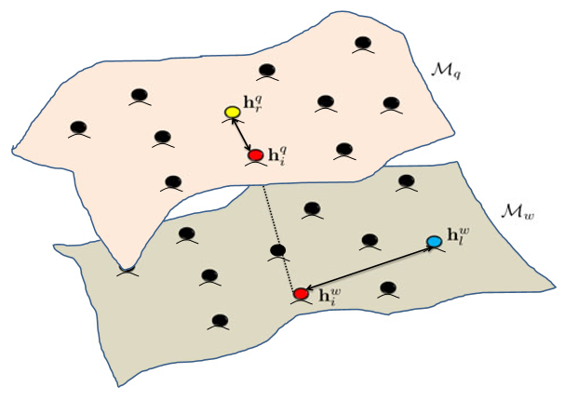
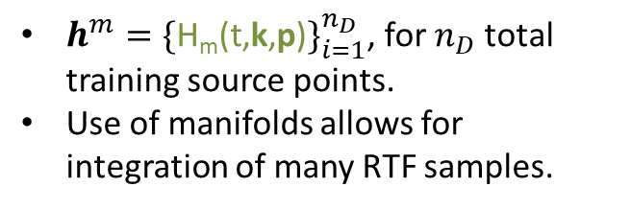
Semi-Supervised Gaussian Processes on Multiple Manifolds
SSGP uses RTFs to infer the position of an unknown source [2].
$h^{m}={\{\text{H}\text{m}\text{(}\text{t}\text{,}\text{k}\text{,}\text{p}\text{)}\}}_{i=1}^{n_{D}}$, for $n_{D}$ total training source points.
Use of manifolds allows for integration of many RTF samples.
Notes:
Here we go deeper into the method that allows for localization of an unknown source using the RTFs we just introduced. That is with a semi supevised gaussian process.
I first mention that in in general we know Gaussian processes to be a nice and convenient choice for modellng random processes as they can be entirely described by their second order statistics.
In our case, we train a model that uses {CLICK} RTFs as input data where the RTFs correspond to set of random acousitic sources in a given acoustic environment (point only top). With the RTFs we build a covariance matrix relating all these different obtained samples or relative view points if you will from each microphone node.
Each node corresponds to a given manifold and these dots represent the same training source but of course are specific to the node which receives them. So in essence {CLICK}, by relating somehow the points from each manifold, we’re able to account for multiple perspectives of the given environment we’re working in.
To relate the RTFs a so-called manifold-based covariance function is used where the covariance is essentially an averaging of the kernel values of all paired RTF samples.

Slide 12
SSGP (Cont.)
Semi-supervised: leverages both labelled and unlabelled data.
Labelled points act as an anchor.
Unlabelled points help interpolate over an area of interest.
Covariance matrix helps infer the position of an unknown source.
Notes:
Another thing to mention here, in general labelled data can be quite tedious to acquire. What the semi-supervised approach allows for is that we only need a small number of labeled points
Unlabeled data is also used. So while labelled points {CLICK} can be seen as sort of like anchors that concretely relates different manifolds, {CLICK} unlabelled data helps interpolate the learned information across the entire
Acoustic envirnoment, or area of interest.
In the end {CLICK}, both are used to help infer the position of an unknown source.

Slide 13
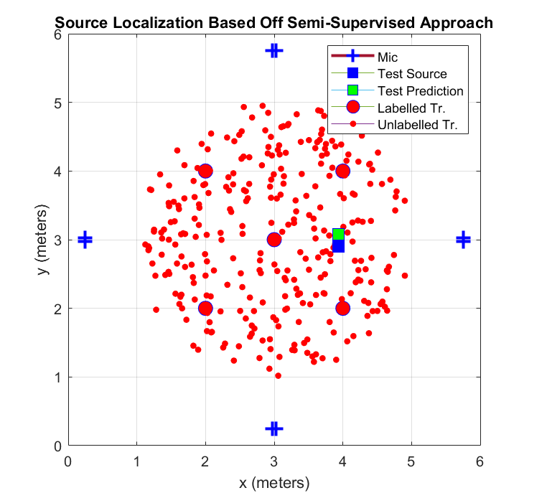
SSGP-Based Localization
Setup:
6m x 6m x 3m room.
4 nodes with 2 microphones per node.
5 labelled and 300 unlabelled training samples.
Speech files drawn at random from the Free ST American English Corpus [4].
Notes:
Here we have an example localization scenario where we assume a 6 by 6 by 3 meter room. {CLICK} We use four microphone nodes, each holding 2 microphones spaced 5cm apart. {CLICK}
We also put to use 5 labelled and 300 unlabelled training data points. Unlabelled points were uniformly sampled at random in a circle with a radius of 2 meters {CLICK}
So for training, we used simply white noise. That is to generate the training RTFs. For the test points with unknown coordinates, we sampled at random speech files from the Free ST American English Corpus. For simulations of the room impulse responses, we used Emaunel Habet’s RIR generator.
That was a brief discussion on the work of Bracha Laufer Goldshtein’s work. I end this section by again motivating the purpose of my project. As should be more clear now, the SSGP localization process relies on training data which is used to characterize a given acoustic environment based on the viewpoiont of our nodes. However, if any of these nodes were to move …. {CLICK}

Slide 14
Misalignment Detection using MRFs
Notes:
We begin here with a general overview of Markov random fields and why they are useful for network misalignment detection in general, and in our context.

Slide 15
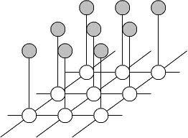
MRFs
Convenient and consistent way of modeling context dependent entities [5,6,7].
Goal: infer information regarding local neighborhoods of hidden nodes (i.e. cliques) that are potentially governed by different distributions.
Can be implemented in a local and massively parallel manner.
Notes:
MRFs provide a convenient and consistent way of modeling context dependent entities. Here we see an example of a group of observations and above are the so-called latent variables that contain information regarding the relational behavior between different neighborhoods or cliques as they’re also called {CLICK}. So this is summarized here. Of course, we assume different cliques may or may not obey some different distribution type or the same distribution but different underlying parameters.
{CLICK} MRFs are also particularly nice to use in terms of computation time which of course is needed for real world applications.

Slide 16
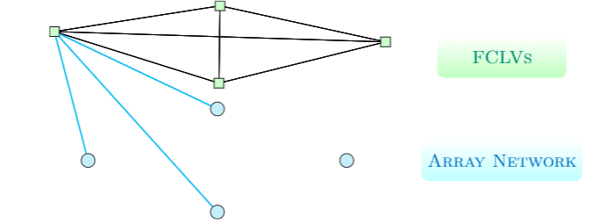
Misalignment Detection using MRFs
Utilize leave one node out (LONO) sub-networks to help infer which array is actually moving.
Each LONO estimates the source position, and inputs to the MRF the error in estimation.
Fully connected latent variables (FCLVs) imply that a given sub-network is either:
Aligned
Misaligned
Uncertain
Notes:
So we‘ve said how it‘s desirable to have a detection algorithm dependent on the localization error. We‘ve also seen how it can be difficult to actually detect anything consistently just based off the error as estimated by the entire network due to the disproportionate outcome of error for a given array shift.
Therefore we propose model that relies on so-called leave one node out or LONO sub-networks {CLICK}. In particular we looked at their individual localization errors.
As we‘ll see in the results section this on its own can provide a marked improvement in identifying movment. However it‘s still has some flaws. Our solution leverages the improvement offered by using LONO sub-networks and the afforded benefits of the MRF we mentioned on the last slide. That is incorporating inforation about the prior distributions of the observed data, or in our case, LONOlocalization errors.
Therefore {CLICK}, the latent variables or latent states if you will that we consider of a given sub-network are {CLICK} aligned, {CLICK} misaligned, or {CLICK} uncertain. The uncertain class can be thought of as a sort of safety net accounting for the error inherent to the SSGP localization process itself. It‘s essentially a garbage class.

Slide 17
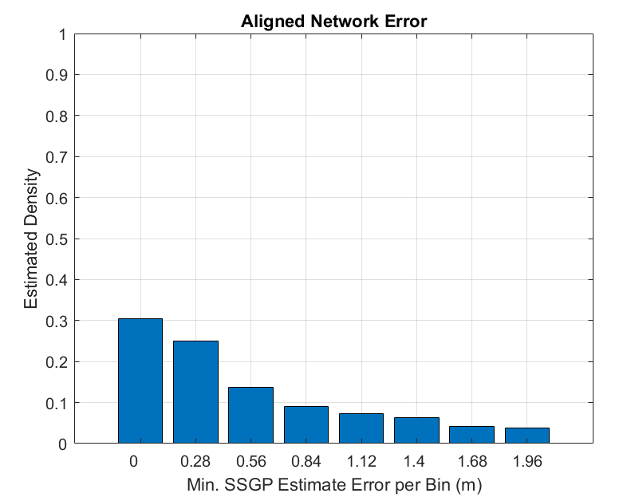
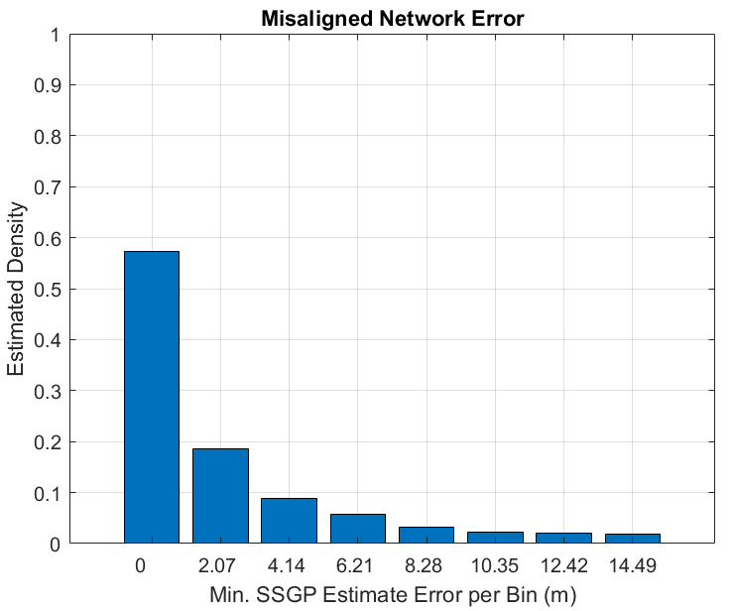
Latent Class Prior Distributions
Aligned case: normal distribution.
Misaligned case: exponential distribution
Parameter estimation involved simulating error for both cases with varying noise and T-60s.
Empirical outcomes inform prior distributions of the two latent classes.
Notes:
Here as you‘ll notice the error distribution, after simulating a series of estimation efforts with the SSGP estimator under varying T60s and noise levels, it follows something like a normal distribution. So this is the aligned class, meaning no shifts in the network and the integrity of the data used for training still holds.
{CLICK} Looking at the misaligned class, we see the range of outcomes is much greater. The distribution we assume here for misaligned case is exponential.
{CLICK} So we mentioned how the aligned case was simulated already, for the misaligned case, we again localized random sources with the SSGP estimator for varying noise and reverberation levels. This time however we incrementally shifted arrays in a random direction, with random rotation and with an incrementally increasing distance from it‘s origin for each set of noise and reverberation level.
{CLICK} So this was the prior information we use to inform the two latent classes mentioned here. For the uncertain class, we assumed a uniform distribution
(as there is really no information gained by obtaining an uncertain measure.)

Slide 18
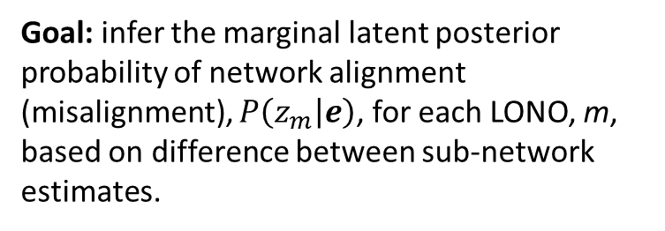
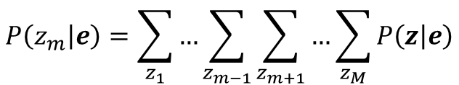
Latent Posterior Probability Estimation
Goal: infer the marginal latent posterior probability of network alignment (misalignment), $P\left(z_{m} | e\right)$, for each LONO, m, based on difference between sub-network estimates.
e_{m} – difference in a given LONO sub-network estimates.
z_{m} – latent variables (aligned, misaligned, uncertain).
$$P\left(z_{m} | e\right)=\sum_{z_{1}}{…\sum_{z_{m−1}}{\sum_{z_{m+1}}{…\sum_{z_{M}}{P\left(z | e\right)}}}}$$
Notes:
Now with this in mind, we look at how we derived the posterior probabilities. Here we have a common equation for calculating the marginal distribution of each LONO’s latent state posterior probabilities.
The m of course refers to different sub-networks. So for our example where we have four nodes, of course there are four sub-networks.
{CLICK} within the equation we denote bold face e to be the set of localization errors for all LONOs.
{CLICK} z of m here references the different possible latent states for each LONO m.

Slide 19
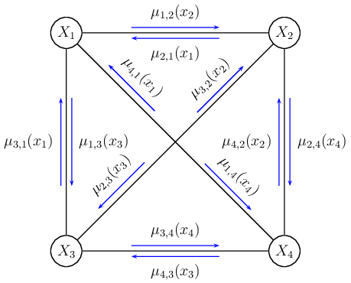
Message Passing Scheme
Belief propagation (BP): infers marginal posterior probabilities for Bayesian networks [8].
Loopy BP: approximate inference method applicable to any graphical model type [9].
Loopy BP follows local message passing schemes at each node and is applicable even in the presence of cycles.
μ_{i,j} – messages with information regarding the latent class priors and observed data passed from LONO i to j.
Notes:
So we used an approximate belief propagation algorithm to infer the marginal posterior probabilities. Its synonymous to the sum-product message passing scheme. {CLICK}
In particular, we used the so-called loopy bp or Pearl’s algorithm which works well when there are loop connections in a given network or in other words, cycles {CLICK}.
It follows a local message passing scheme {CLICK}
And here in the visual, we can see each sub-network X has a set of observations, that being the localization error, and passes that information along to all other nodes. The observation data is embedded in the variable mu, along with prior distribution information. Specifically it is the product of the observation of a given LONO, and a probabilistic value of the observation being in a given latent state based off of the empirical error distributions.

Slide 20
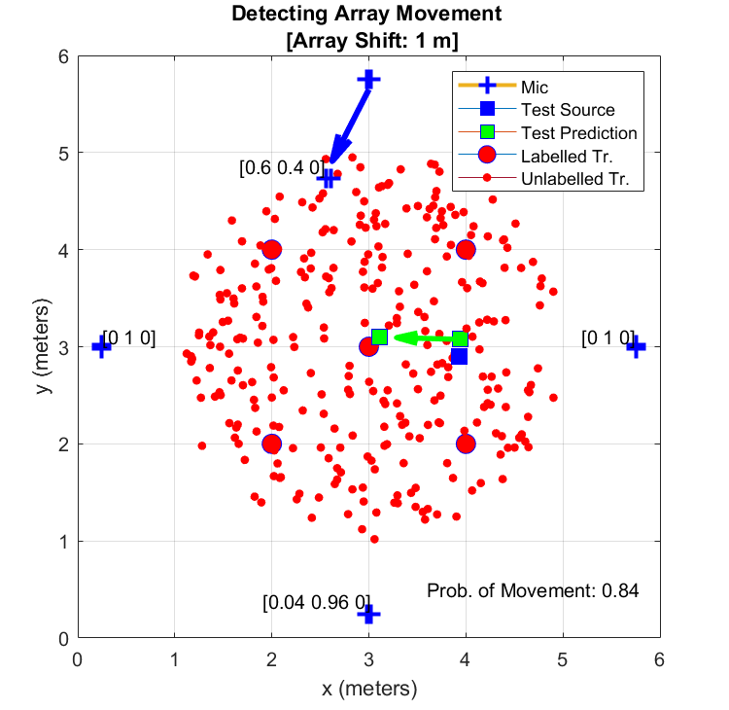
Misalignment Detection using Markov Random Fields
Labels, [a,b,c], denote latent state probabilities for each LONO sub-network.
Labelled node is the node left out.
LONO without the moving array should indicate alignment.
Notes:
Here we see an example of the detection algorithm in action.
As indicated by the arrows an array is shifted one meter, and as a result we see our original estimation of the source is skewed.
And then in the brackets we see the set of posterior latent state probabilities, in the order of alignment, misalignment and uncertain. {CLICK}
Note that the probabilities listed at a given node references the sub-network that leaves that node out.
{CLICK} The LONO without the moving array should indicate alignment. So for example, with this array being the one that’s compromised, the sub-network without it should yield a reading of alignment as they haven’t moved. This is of course reflected here.
It’s worth mentioning, for our experiment an assumption we make is that only one node moves at a time.
Finally, we calculate the probability of movement in the overall network as the average of all the subnetwork’s probability of misalignment.

Slide 21
Results

Slide 22
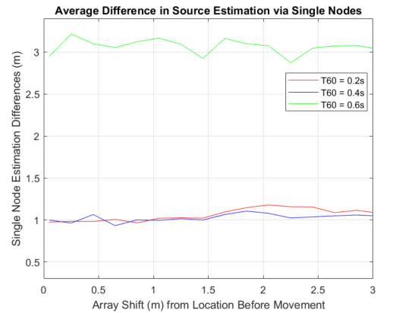
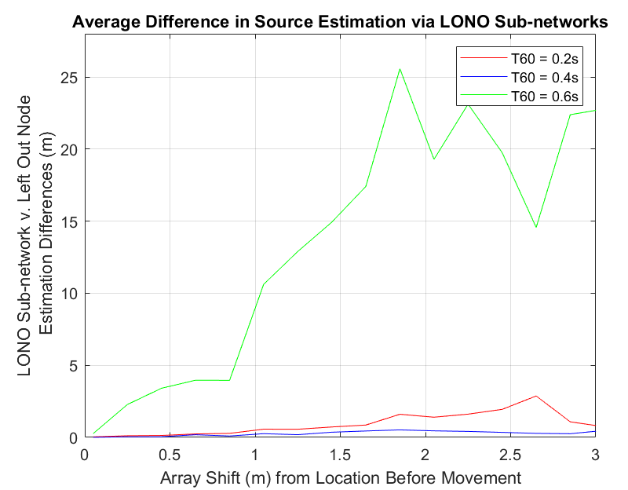
Naïve Comparison
Single node localization estimate comparison.
Error not well correlated to shift.
LONO estimate comparison (the input to the MRF model).
Estimate now correlated with shift but highly variable.
Notes:
Before we look closer at the results of the MRF-based detector, I’ll introduce some of the naïve estimates we compared it to.
First was a single node estimation, where we compare all of the different estimates from each node.
In particular, we say if the difference in estimation of a source between one node and the average reading of the other three exceeded some threshold value, then we said detection was warranted {CLICK}.
Note that again, similar to the results we saw in the beginning with the full network estimates, the shift size and the difference in position estimation between the moved node and the average of the other three are not very well correlated. {CLICK}
The other naïve method we considered was the difference in estimation between LONO networks. Again we compare each LONO’s estimate to the average of the others and use a threshold value to determine if movement occurred.
{CLICK} Note that there is a stronger relation here but it’s still quite variable and on a scale that makes it quite hard to threshold.

Slide 23
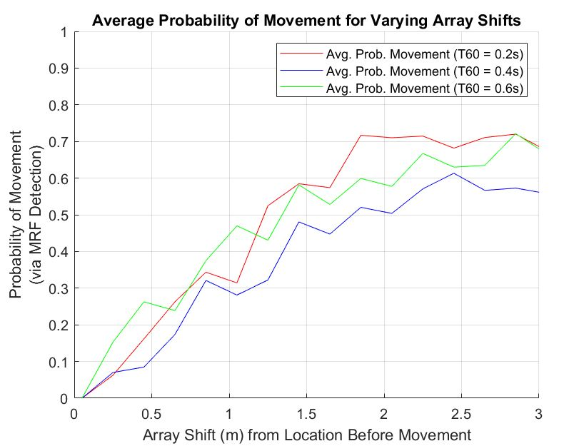
MRF Node Detection Results
Output is proportional to the size in shift.
Mostly independent to the level of reverberation.

Slide 24
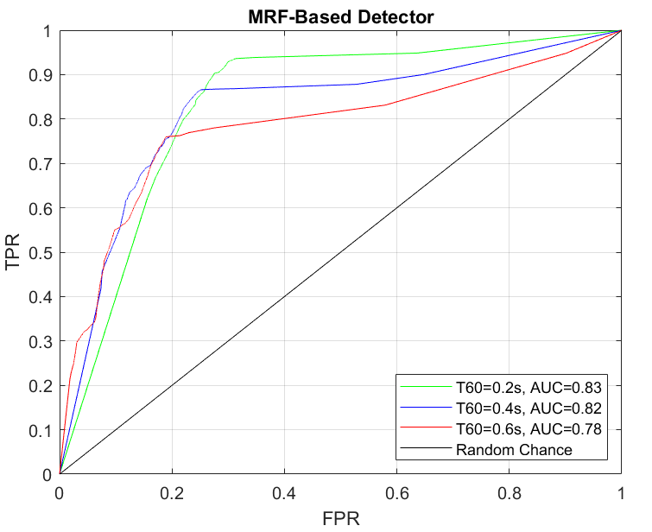
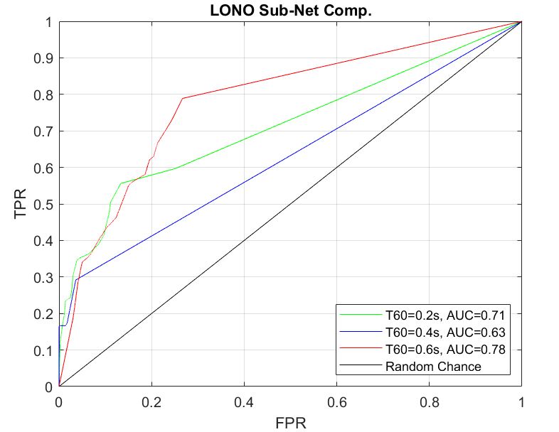
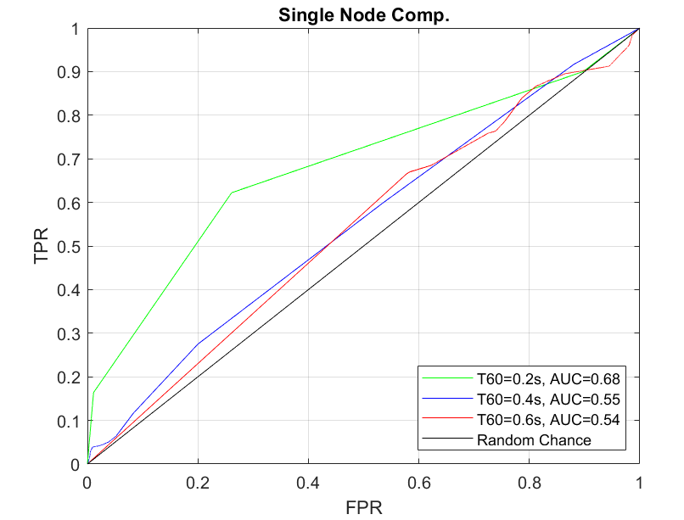
Results – ROC Curve
Sub-network estimate presents advantage to naïve single node estimate.
MRF-based detector shows clear advantage for different levels of reverberation.
Notes:
We also ran some tests for the different detectors to compare there performance.
So essentially, we varied the amount of error allowed from the SSGP localizer as a ground truth, that is to indicate when detection is warranted. So for example if the ground truth was 5cm and after movement the localization error was only 2cm we said movement should not be detected. The ground truth range we chose was based off the mean error without movement plus and minus a standard deviation.
Also, along with the ground truth, we also varied threshold values for the detectors specific to the error of the naïve sub-network configuration without movement (i.e. when we say the detector flags movement).
So here we the results for the naïve single node comparison estimate. It’s of course only barely more helpful than flipping a coin to determine if there was movement in the network.
{CLICK} Here we have the LONO estimates and of course we already see an advantage reflected in the area under the curve.
{CLICK} However, with MRF-based detector across the board, for all reverberation levels, the detection ability is enhanced.

Slide 25
Conclusions

Slide 26
Conclusions
Proposed an algorithm that probabilistically assesses whether a network of nodes is aligned.
Detects movement with a value that scales commensurate with the size of disruption in the network.
MRF model beneficial in comparison to naïve estimates that rely directly on positional estimation errors.
Notes:
Read read read… after 3:
With the benefit of the MRF model being the incorporation of prior knowledge i.e. the error distribution.

Slide 27
References
[1] Laufer-Goldshtein, B., Talmon, R., and Gannot, S. (2017). Speaker Tracking on Multiple-Manifolds with Distributed Microphones. LVA/ICA.
[2] Laufer-Goldshtein, B., Talmon, R., and Gannot, S. (2017). Semi-Supervised Source Localization on Multiple Manifolds With Distributed Microphones. IEEE/ACM Trans. Audio, Speech and Lang. Proc. 25, 7 (July 2017), 1477–1491.
[3] Talmon, R., Cohen, I. and Gannot, S. (2009). Relative Transfer Function Identification Using Convolutive Transfer Function Approximation. Trans. Audio, Speech and Lang. Proc. 17, 4 (May 2009), 546–555.
[4] ST-AEDS-20180100_1, Free ST American English Corpus
[5] Akai, N., Morales, Y., Hirayama, T. and Murase, H. (2019). Misalignment Recognition Using Markov Random Fields with Fully Connected Latent Variables for Detecting Localization Failures.
[6] Stan, L.Z. (2009). Markov Random Field Modeling in Image Analysis (3rd. ed.). Springer Publishing Company, Incorporated.
[7] Boykov, Y., Veksler, O. and Zabih, R. (1998). Markov Random Fields with Efficient Approximations. In Proceedings of the IEEE Computer Society Conference on Computer Vision and Pattern Recognition (CVPR ’98). IEEE Computer Society, USA, 648.
[8] Knoll, C., Rath, M., Tschiatschek, S. and Pernkopf, F. (2015). Message Scheduling Methods for Belief Propagation.
[9] Christopher M. Bishop (2006). Pattern Recognition and Machine Learning (Information Science and Statistics). Springer-Verlag, Berlin, Heidelberg.
Notes:
And before wrapping up and opening things up to questions, I do point to some of the literature that was critical in the development of this project. In particular Bracha Laufer-Goldshtein’s paper on semi-supervised source localization of course and then the paper on misalignment recognition using MRFs done last year by a group in Japan.
I should say, there has been a good deal of past and recent literature in the field of ROBOTICS using MRFs for detecting misalignment in sensor networks umm, which was where we sourced the idea for our project.
And so with that I say thank you for your time.

Slide 28
Thank you

